Slide 1
4. Proposition Logic

Slide 2
The Story
Propositions (statements) which we can assign a truth value to
It is Friday today
Tomorrow was wet
Logical operators (or connectives)
Conjunction (and)
Disjunction (or)
Implication
Bi-conditional
Using truth tables
Using Inference for logical Proof

Slide 3
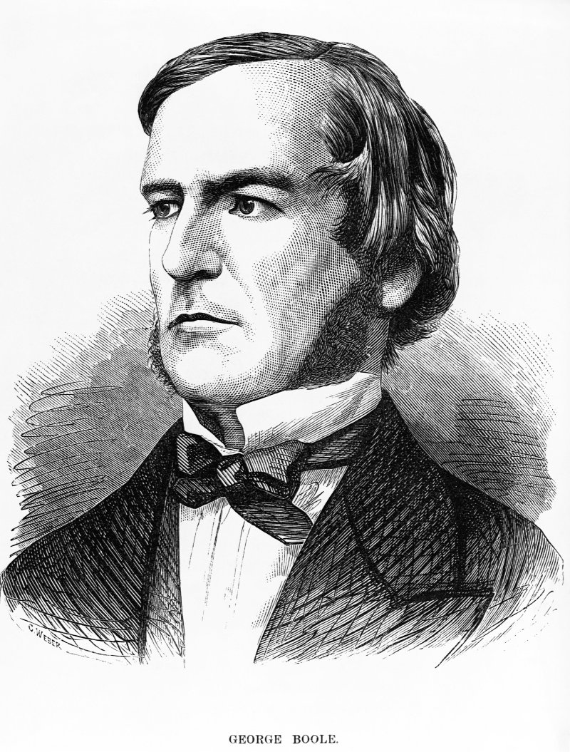
George Boole
http://www.computerhistory.org/revolution/digital-logic/12/269/1330

Slide 4
Connectives between Propositions
True is written as 1
False is written as 0
¬p
p∧q conjunction
p∨q disjunction
p⟶q implication
p⟷q biconditional

Slide 5
Truth tables for basic operations
p q ¬p p∧q p∨q p⟶q p⟷q
0 0 1 0 0 1 1
0 1 1 0 1 1 0
1 0 0 0 1 0 0
1 1 0 1 1 1 1

Slide 6
Truth table for (p∨¬q)∧r
p q r (p∨¬q) (p∨¬q)∧r
0 0 0
0 0 1
0 1 0
0 1 1
1 0 0
1 0 1
1 1 0
1 1 1
p q r (p∨¬q) (p∨¬q)∧r
0 0 0 1 0
0 0 1 1 1
0 1 0 0 0
0 1 1 0 0
1 0 0 1 0
1 0 1 1 1
1 1 0 1 0
1 1 1 1 1

Slide 7
Exercise
Give truth tables for each of the following propositions:
p ⟶ ( q ⟶ r)
P ⟷ ( q ∧ r )

Slide 8
p⟶(q⟶r)
p q r (q⟶r) p⟶(q⟶r)
0 0 0 1 1
0 0 1 1 1
0 1 0 0 1
0 1 1 1 1
1 0 0 1 1
1 0 1 1 1
1 1 0 0 0
1 1 1 1 1

Slide 9
p⟷(q∧r)
p q r (q∧r) p⟷(q∧r)
0 0 0 0 1 True
0 0 1 0 1 True
0 1 0 0 1 True
0 1 1 1 0 False
1 0 0 0 0 False
1 0 1 0 0 False
1 1 0 0 0 False
1 1 1 1 1 True

Slide 10
What can you determine with truth tables?
Tautologies
Contradictions
Satisfiability
Equivalence

Slide 11
Tautology. A statement that is true in every row of a truth table. A tautology is a formula that is always true, or true for every assignment of truth values to its simple components.
Contradiction. A statement that is false in every row of a truth table. A contradiction is a formula that is always false, or false for all possible values of its variables.
Satisfiability. A compound proposition is satisfiable if there is a truth assignment that satisfies it, meaning at least one entry of its truth table is true.
Equivalence. To determine if two sentences are logically equivalent, you can use complete truth tables. If the two sentences are logically equivalent, (i.e the same Os and 1s) then we say that they are “equivalent” and use the triple equals sign ≡

Slide 12
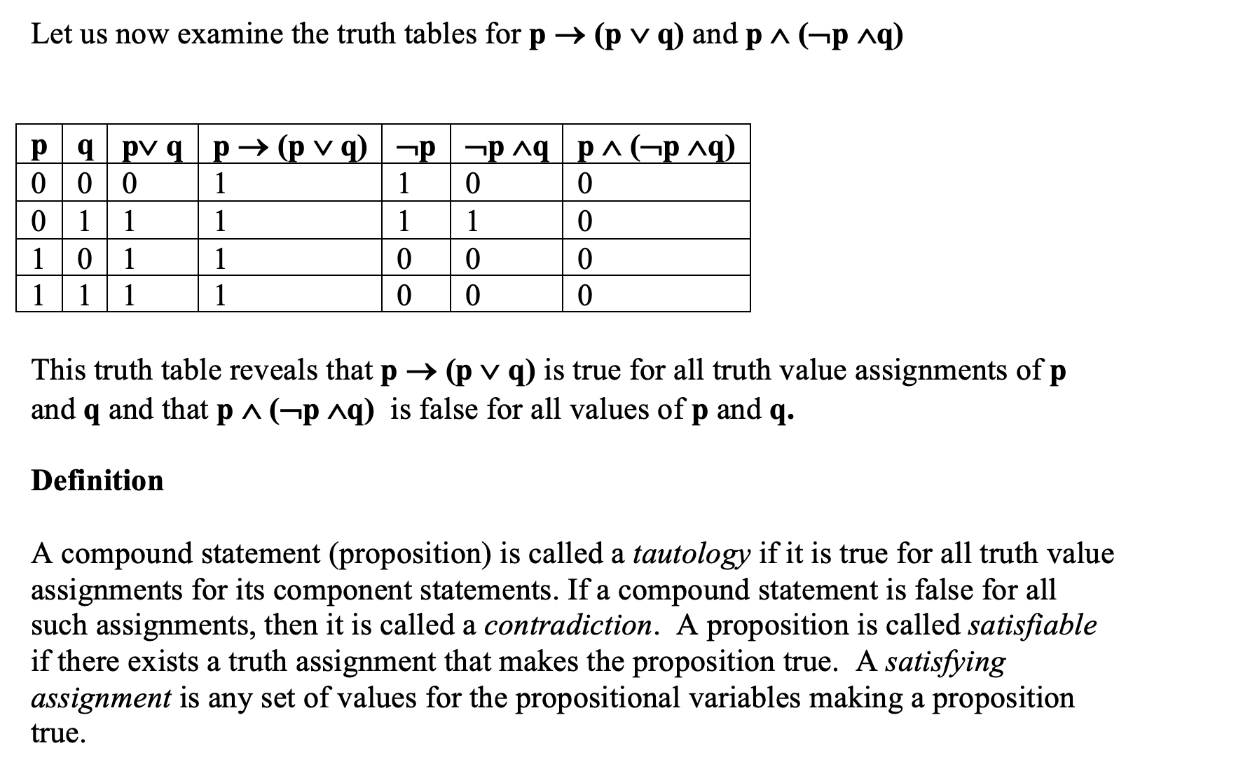

Slide 13
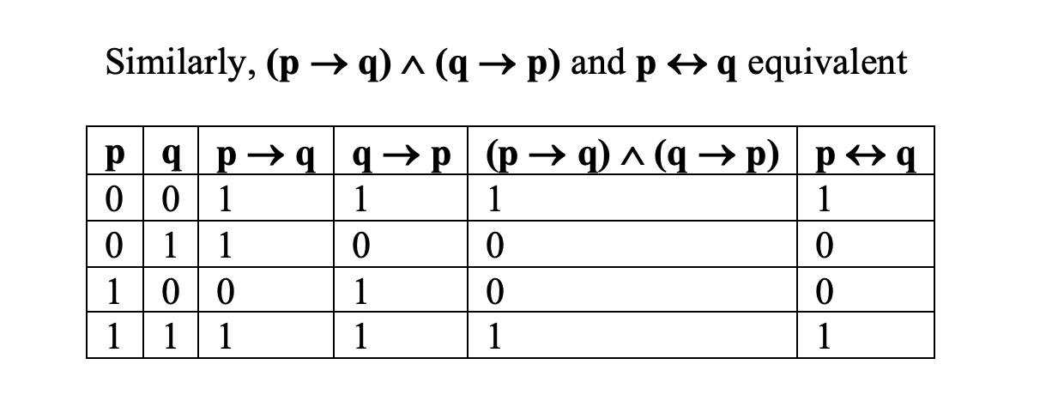
Some equivalences

Slide 14
Some equivalances
Idempotent: p∧p ≡ p, p∨p ≡ p
Double negation: ¬¬p ≡ p
Law of excluded middle: p∨¬p ≡ true
Commutative: p∨q ≡ q∨p, p∧q ≡ q∧p
Bi-implication: p⟶q ∧ q⟶p ≡ p⟷q
Implication: p⟶q ≡ ¬p∨q
Associative: p∧(q∧r) ≡ (p∧q)∧r,
p∨(q∨r) ≡ (p∨q)∨r

Slide 15
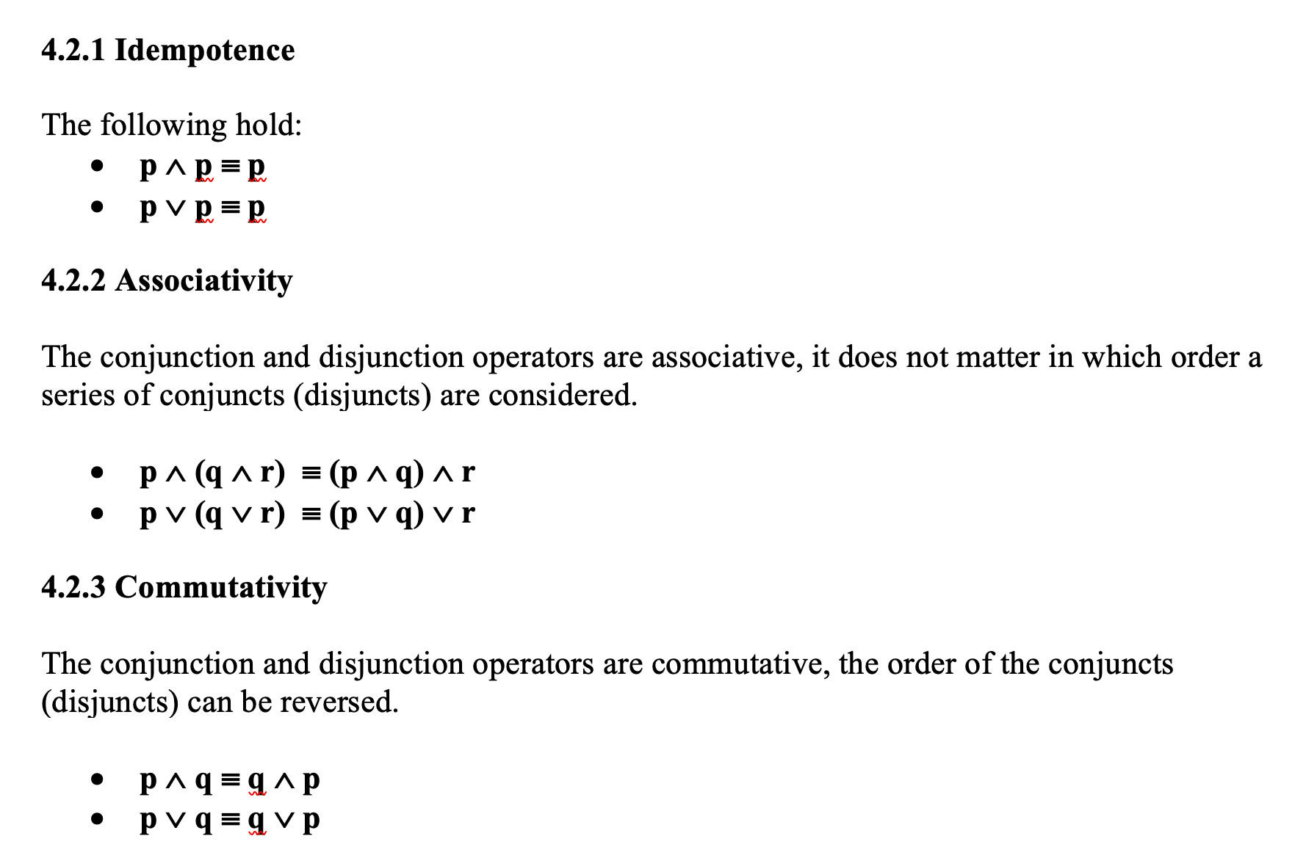
Logical Equivalences I

Slide 16
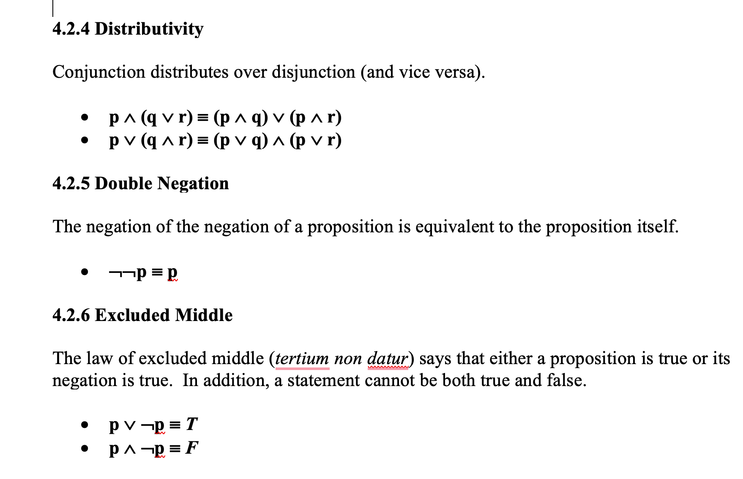
Logical Equivalences II

Slide 17
Some equivalances
de Morgan: ¬(p∧q) ≡ (¬p∨¬q)
¬(p∨q) ≡ (¬p∧¬q)

Slide 18
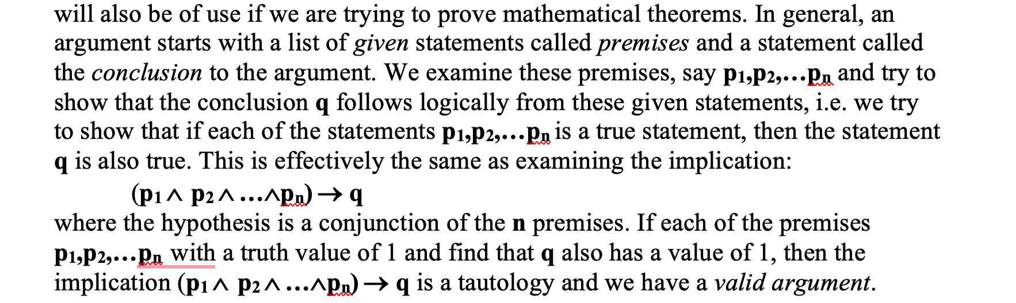
Valid Argument

Slide 19
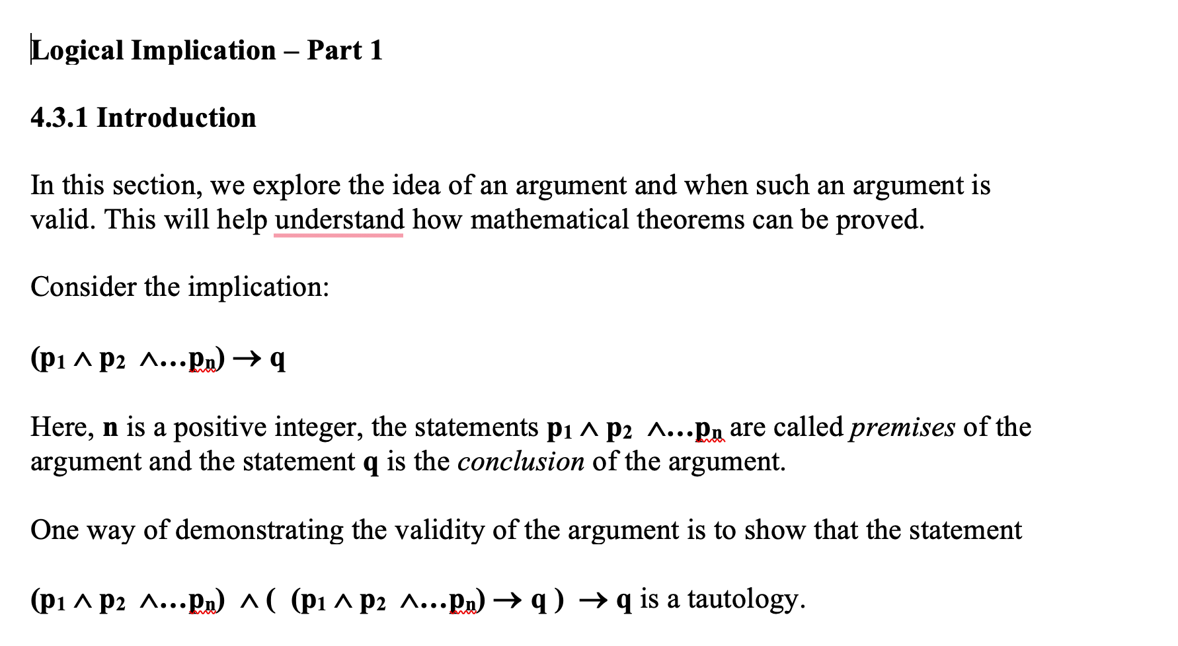

Slide 20
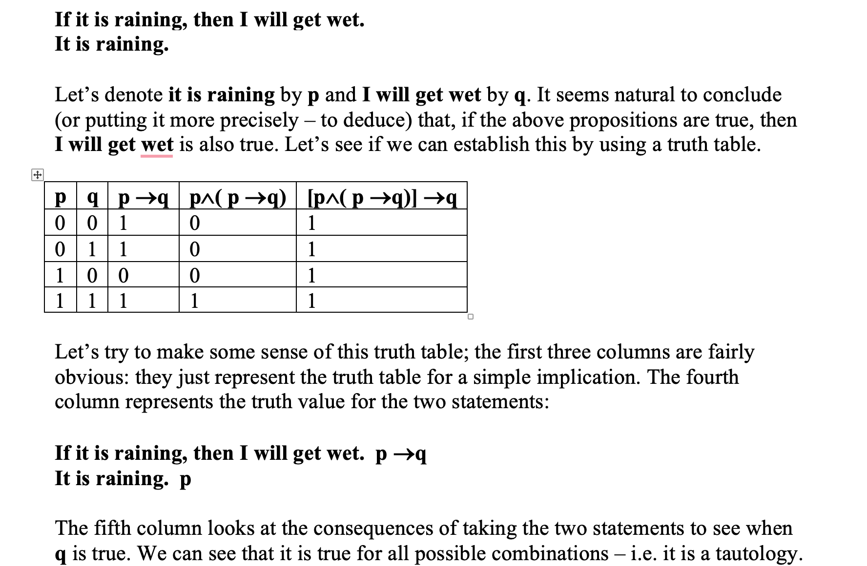

Slide 21
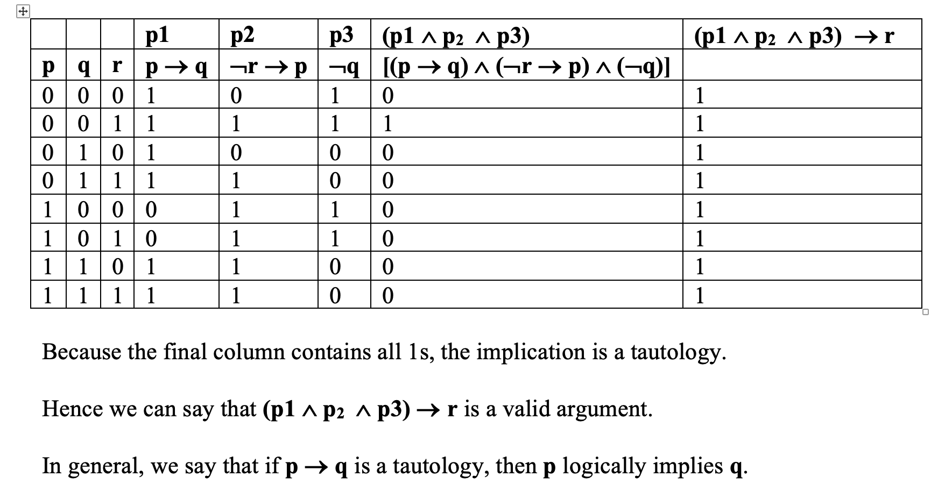

Slide 22
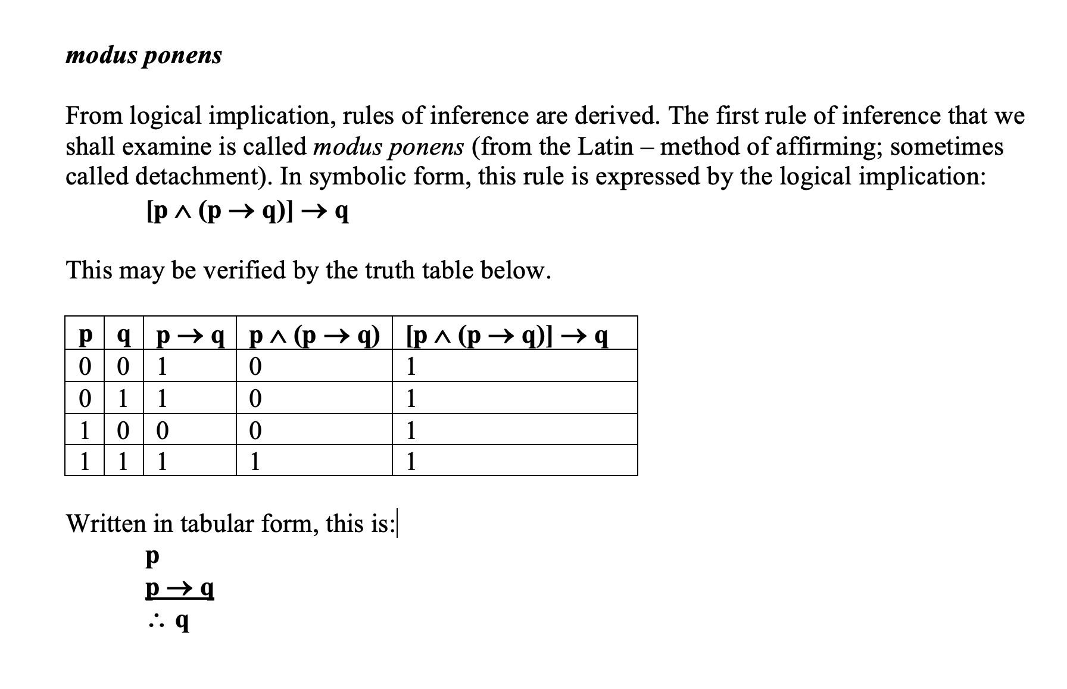

Slide 23
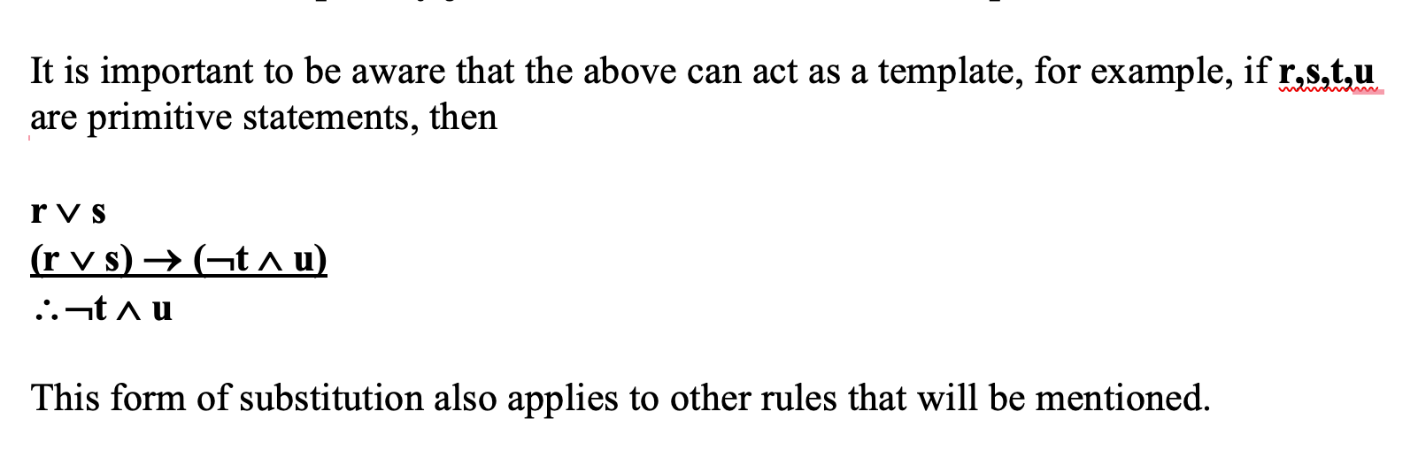
Extending MP

Slide 24
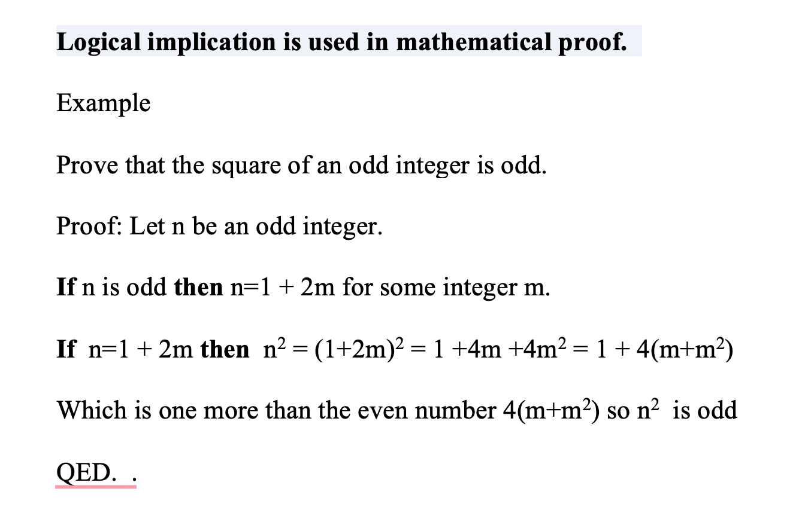

Slide 25
Seom Rules of Reasoning
Modus ponens: (p ∧ (p⟶q)) ⟶ q
Syllogism: ((p⟶q) ∧ (q⟶r)) ⟶ (p⟶r)
Modus tollens: ((p⟶q) ∧ ¬q) ⟶ ¬p
Disjunctive syllogism: ((p∨q) ∧ ¬p) ⟶ q
Reductio ad absurdum: (¬p⟶0) ⟶ p

Slide 26
Exercise
Suppose:
p means the screen is off
r means processes are running
q means the music has stopped
s means power is being used
And that the following are ALL true
¬p⟶r If the screen is on then processes are running
r⟶s If processes are running then power is being used
p⟶q If the screen is off then the music has stopped
Show that if the music has not stopped then power is being used
¬q ⟶ s

Slide 27
What do we know is true?
¬p⟶r ¬q
r⟶s
p⟶q
Using syllogism we have
∴¬p⟶s
Using modus tonens we have
∴¬p
Using modus ponens we then have
∴s

Slide 28
Assessed MCQ 2
The second assessed MCQ is next week
It’s about logic, covering this week and next week
As before, 40mins, open book in your own time and on your own
+4 for correct, -1 for incorrect, 0 for leave blank
The quiz opens at 2pm Thursday 31st and closes 8pm Sunday 3rd (ie start by 7:20pm)

Slide 29
Team vote
Would you like me to record a couple of examples?

